Slide 1
MLB Database Structure
Nam Tran

Slide 2
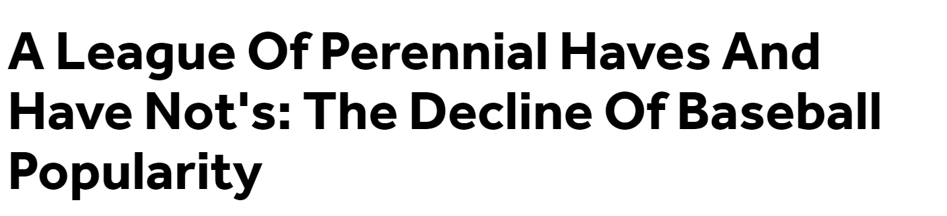
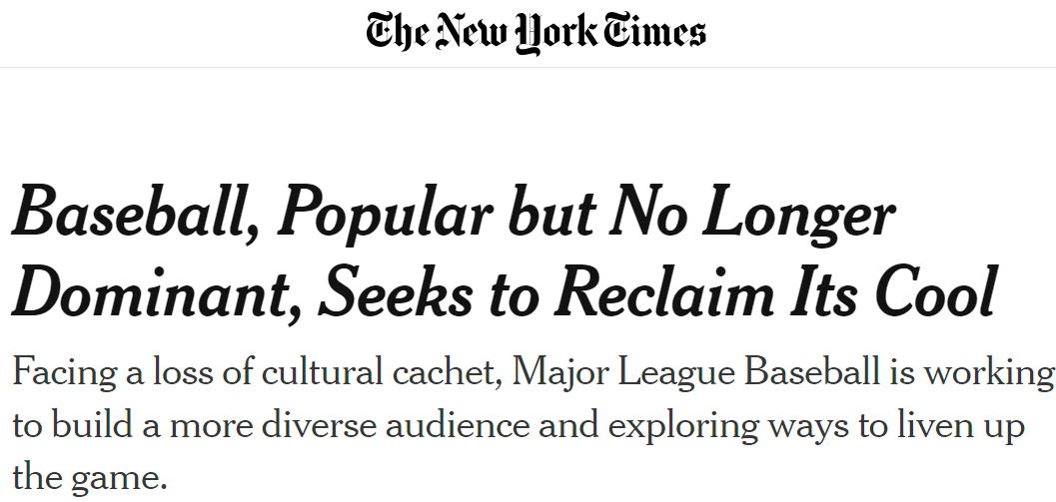
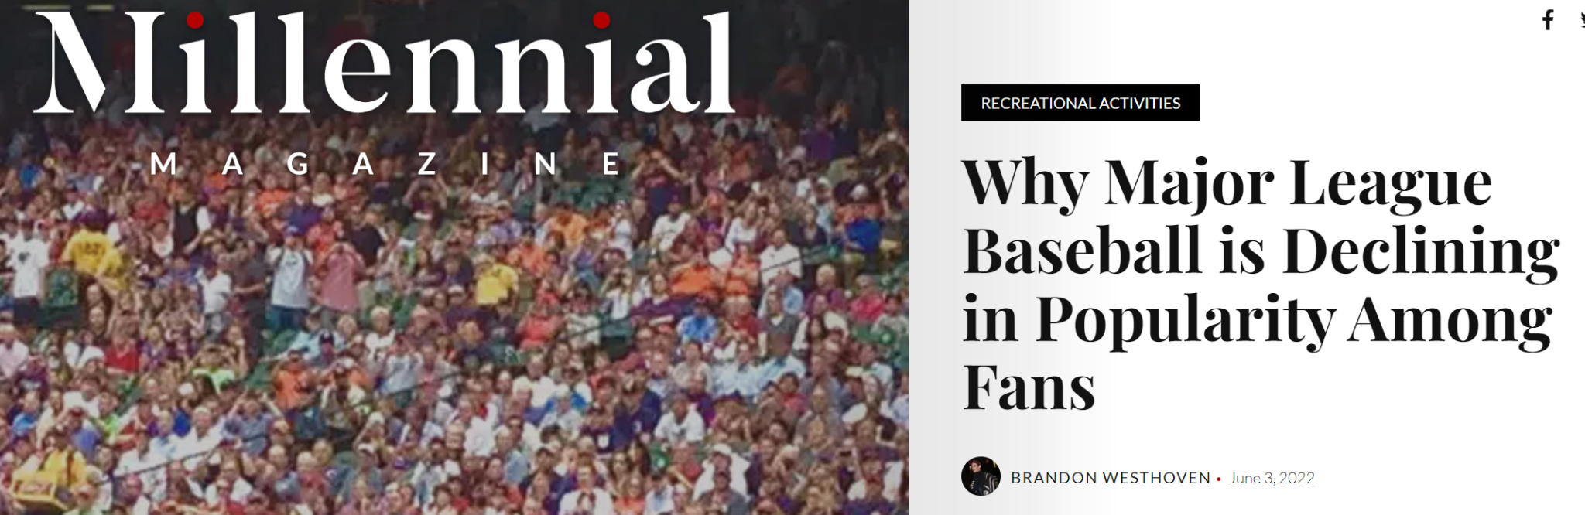
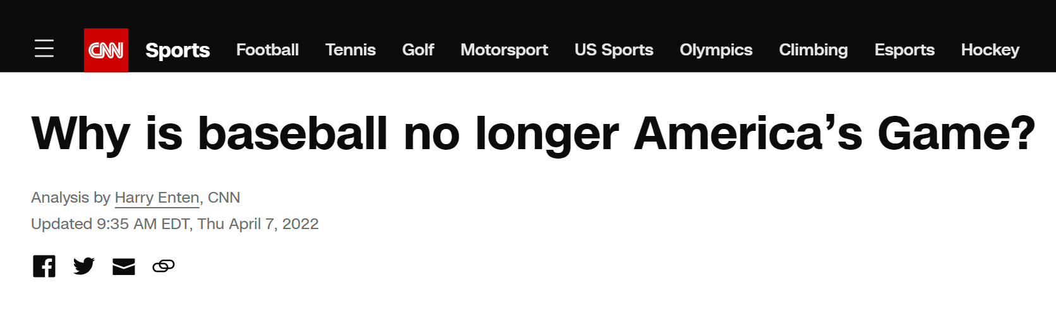

Slide 3
Business Problem
Major League Baseball (MLB) has been facing a decline in popularity in recent years. Our objective is to design a comprehensive database that not only helps maximize the revenue of the MLB but also helps in making data-driven decisions to improve the league's popularity. Thus, the MLB needs a centralized and structured database to efficiently manage its complex operations.

Slide 4
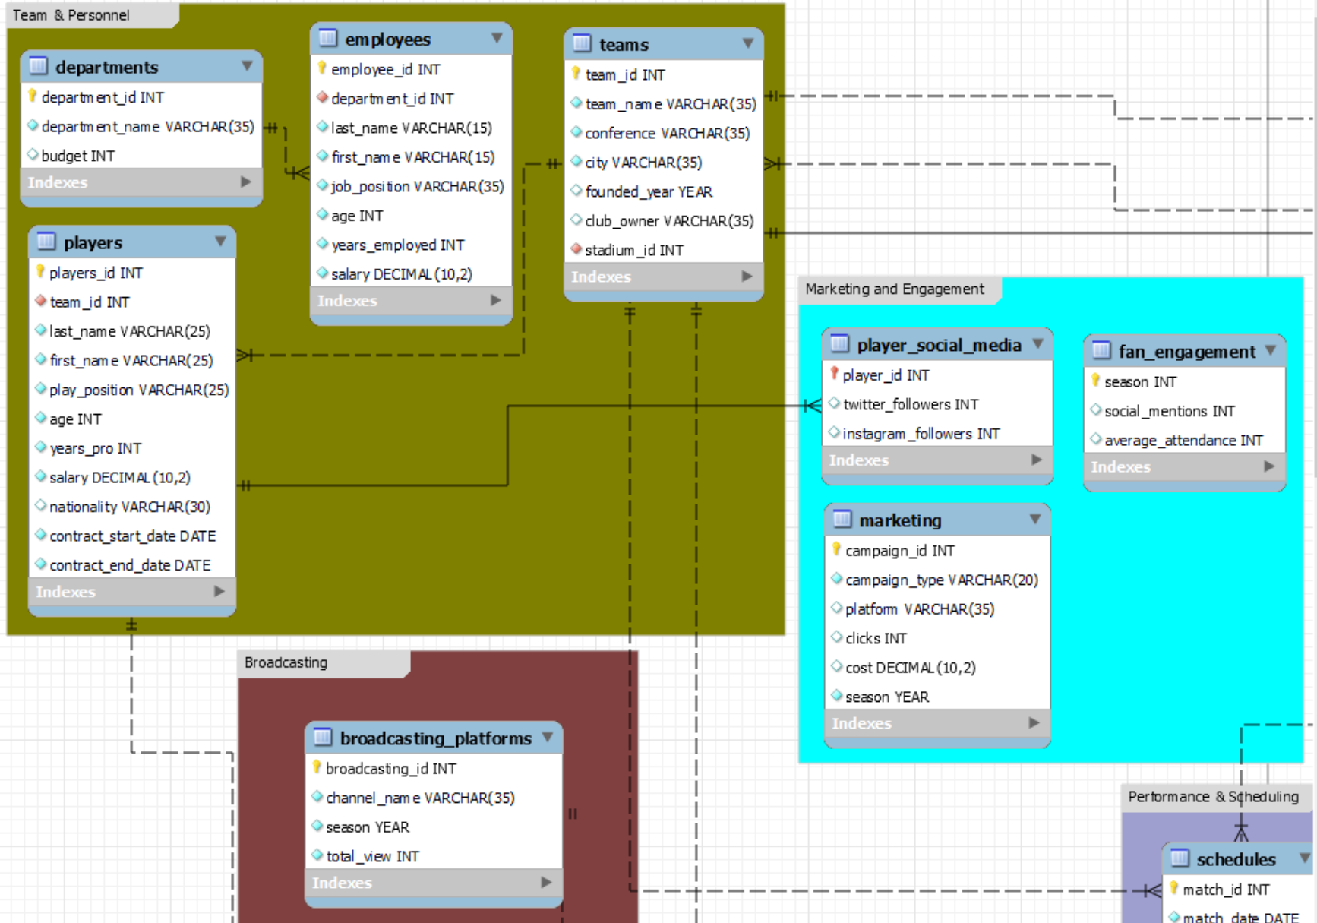
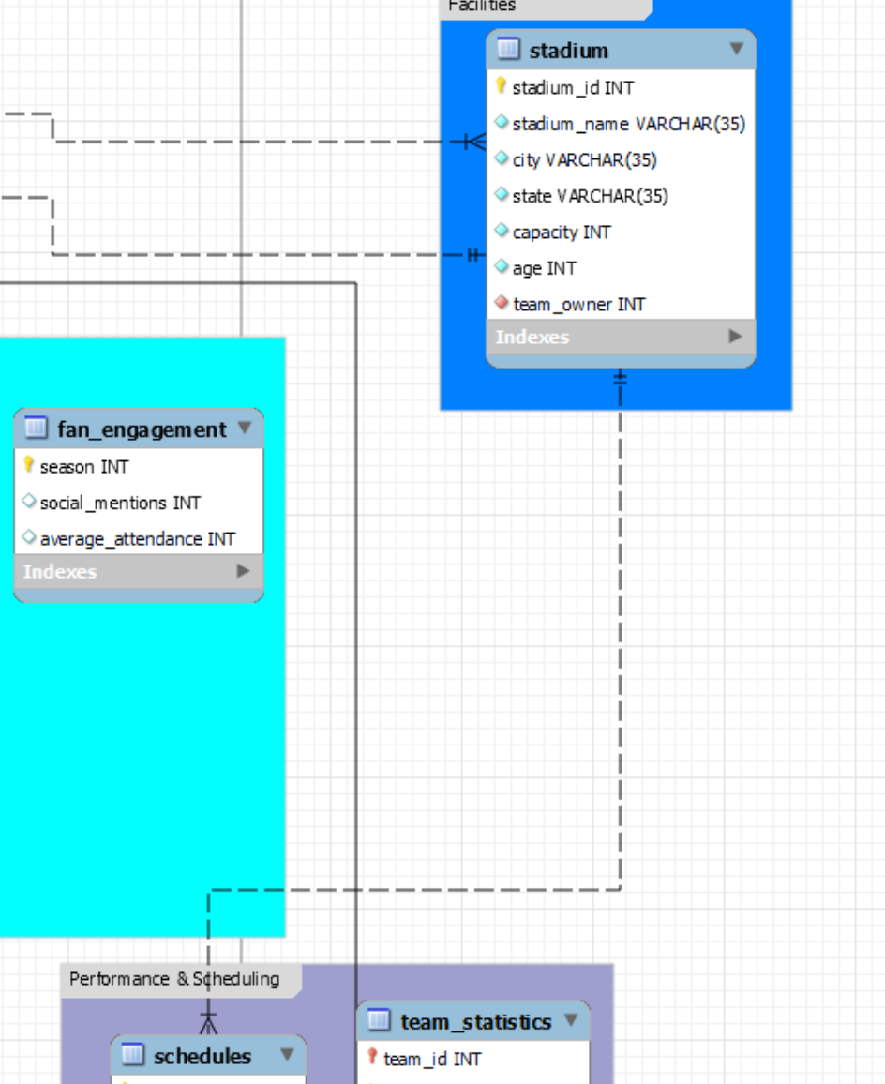
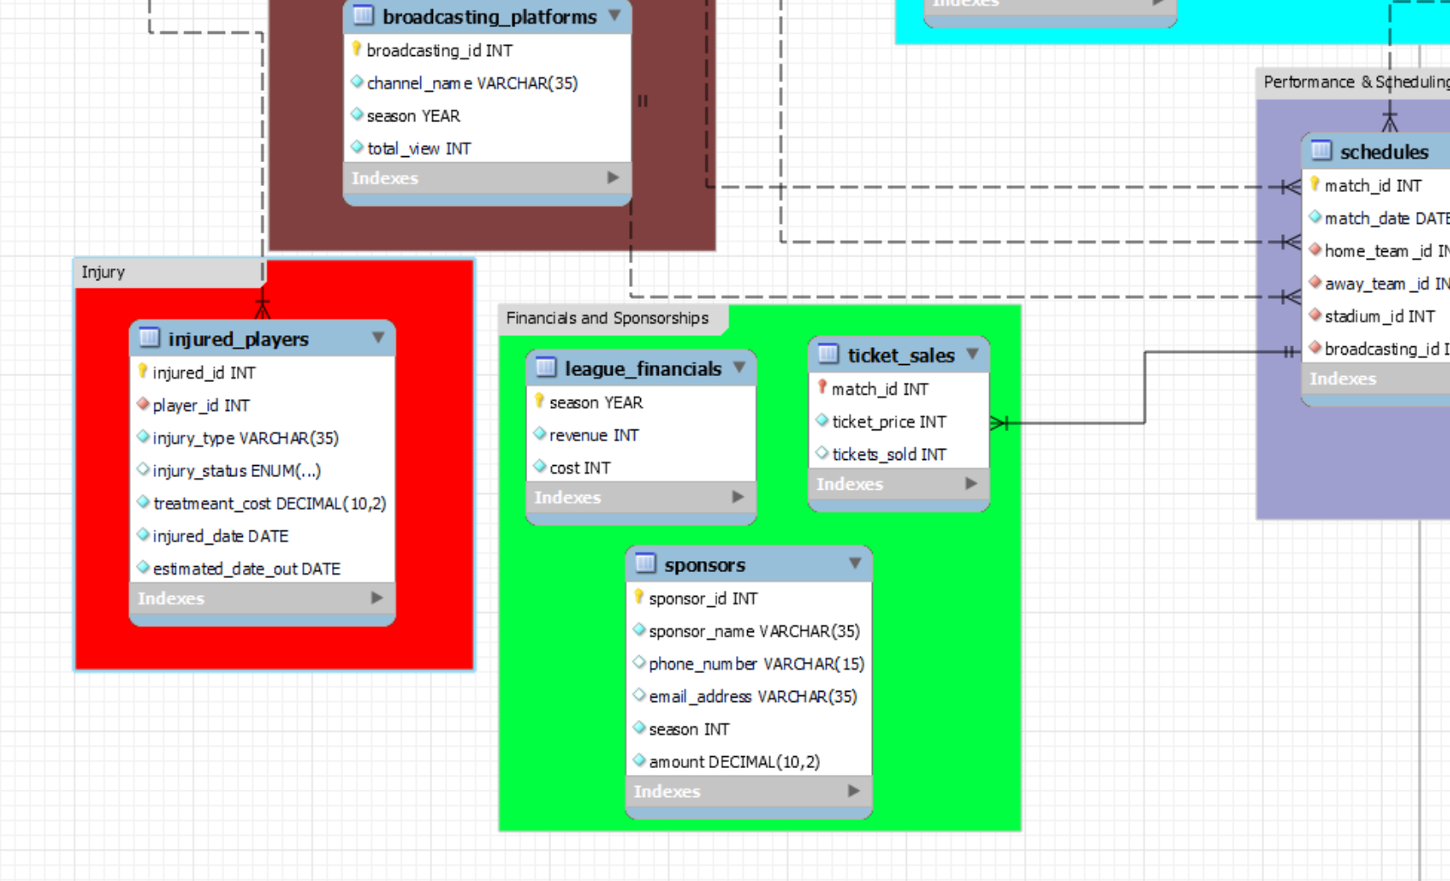
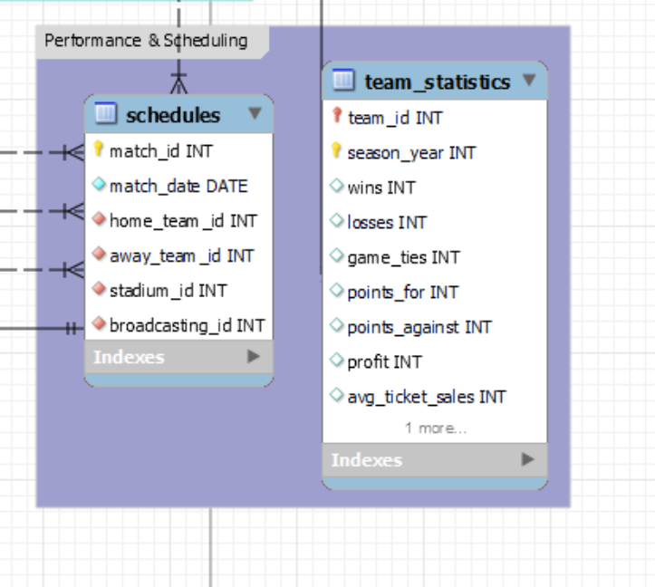
ERD Diagram
Notes:
7 groups
Team & personnel (greenish)
Broadcasting (maroon)
Injury (red)
Financials & sponsorships (lime green)
Performance & scheduling (light purple)
Marketing & engagement (teal)
Facilities (blue)

Slide 5
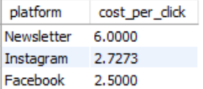
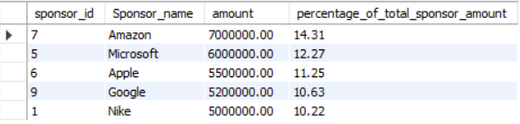
Financial Perspective
Top 3 most cost effective cost per click marketing platform
Who are the top 5 sponsors of the MLB and how much do they contribute to the league?

Slide 6
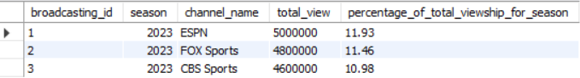
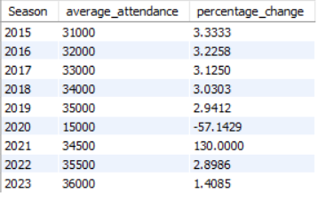
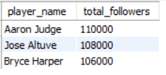
What were the top 3 broadcasting platforms and the percent of viewership they have for the whole season?
Fan engagement Perspective
What is the percentage change in attendance for MLB games from 2015-2023?
What are the top 3 players that have the highest combined social media following (Twitter + Instagram) in 2023?

Slide 7
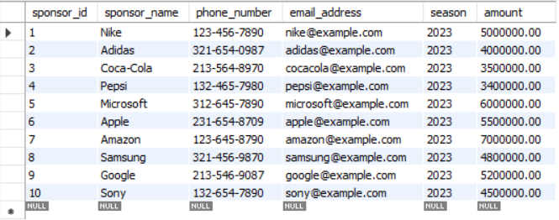
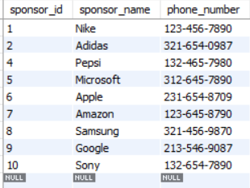
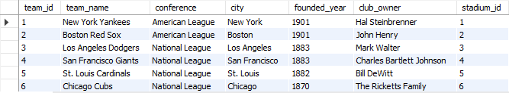
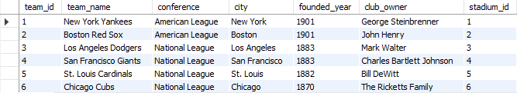
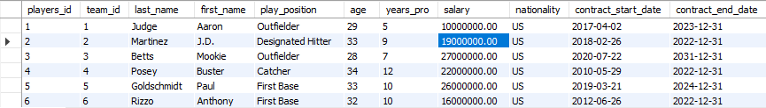
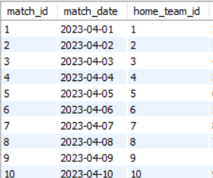
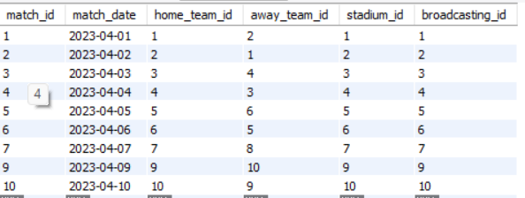
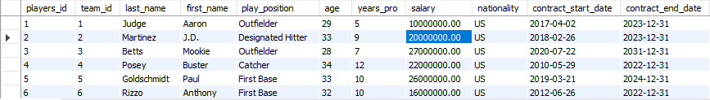
Update and Delete Table
Update |  | Delete
The team owner of team 1 passed away, and his son inherited the team, so we need to update the team owner name. |  | Coca-cola decides to end its sponsorship with the mlb
Because of Player 2’s good performance, we decided to promote the salary for him. Before |  | Match 8 of the season is cancelled due to weather forecasts indicating a storm

Slide 8
Thanks for listening!
Do you have any questions?

